Slide 1


Slide 2

Sentiment Analysis to Rate a Product

Slide 3
Group Members Introduction
Project Group ID: F220227F86
Group Member Name: FAHAD
VU ID: BC190202247

Slide 4
Abstract
Sentiment analysis, commonly referred to as opinion mining or emotion AI, uses computational linguistics, biometrics, natural language processing, and text analysis to systematically detect, extract, quantify, and investigate emotional states and subjective data. To determine how customer, feel about a product, businesses frequently utilize sentiment analysis.
When purchasing a product online, a customer has the option of leaving feedback. Comments can be used as types of feedback. A new customer cannot read every remark any longer in order to make a purchasing decision. You must create a program that can assess a product's quality using an analysis of the sentiment of user reviews.
It is an online store application where only customers who have registered can browse products (which can be of any type) and their features and leave comments about them. Other customers' remarks are also visible to the user. The program will evaluate and rate each comment made about a product.

Slide 5

INTRODUCTION OF PROJECT
The sentiment analysis-based online shopping website project aims to provide users with valuable insights into the sentiments expressed in product comments. By incorporating sentiment analysis techniques and visualization tools, the website enhances the user experience, enabling informed decision-making and facilitating a more personalized shopping experience.
The project involves the development of a user-friendly online shopping platform that allows users to explore and purchase electronic products. Through the integration of a sentiment analysis tool, user comments are analyzed, and sentiment scores are assigned to assess the overall sentiment towards each product.

Slide 6
The project also includes an evaluation phase, where the accuracy of the sentiment analysis outcomes is assessed. A user case study is conducted to compare the sentiment scores generated by the sentiment analysis tool with user feedback. By gathering user assessments and comparing them with the analysis outcomes, the project aims to gauge the effectiveness and reliability of the sentiment analysis tool.
Overall, this project aims to create a comprehensive and user-centric online shopping experience by leveraging sentiment analysis techniques, visualization tools, and accuracy assessments. By providing users with valuable insights into product sentiments, the website empowers them to make informed decisions, fostering customer satisfaction and enhancing the overall user experience.

Slide 7
Methodology
A software development methodology, also known as a system development methodology, is a framework or approach used in software engineering to guide and manage the process of developing an information system or software application. It provides a structured and systematic way to plan, organize, and control the various activities involved in the development lifecycle.
The purpose of a software development methodology is to establish a set of guidelines, processes, and practices that help ensure the successful completion of a software project. It provides a framework for teams to collaborate effectively, manage resources, and deliver high-quality software products.

Slide 8
Data Domain
The data domain in the context of this project would encompass the specific types and categories of data that are relevant to your electronic products online shopping website. It includes the scope of data that will be stored, processed, and managed within the system. Here are some examples of the data domain:
User Data
Product Data
Sentiment Analysis Data
Administrative Data
System Configuration & Settings

Slide 9
Preprocessing
In the context of this project, preprocessing refers to the steps and techniques applied to raw data before it is used for sentiment analysis or other tasks. Preprocessing helps to clean, transform, and prepare the data for further analysis. Here are some common preprocessing techniques that can be applied to the data in your project:
Data Cleaning
Text Normalization
Tokenization
Stop Word Removal
Stemming or Lemmatization
Handling Negations & Emphasis

Slide 10
Sentiment Analysis using Tool
Sentiment analysis using a tool involves utilizing a specific software
or library that is designed to perform sentiment analysis tasks. In this
project, I used the PHP Sentiment Analyzer tool for sentiment
analysis. Here's an overview of how sentiment analysis can be
conducted using this tool:
Integration
Text Input
Preprocessing
Sentiment Analysis
Sentiment Classification
Output & Analysis

Slide 11
Manual Sentiment Analysis
Provide here the diagrammatic view of your team structure and key responsibilities. Filled Later

Slide 12
Project Schedule
Provide the Schedule (Gantt Chart) of your
project here. Filled Later

Slide 13
Results and Evaluation
The "Results and Evaluation" chapter focuses on evaluating the outcomes and effectiveness of the developed online shopping website with sentiment analysis capabilities. This chapter presents an assessment of the project's success in achieving its goals and objectives, along with an analysis of the obtained results. The evaluation process aims to determine the impact and usefulness of the sentiment analysis feature, analyze the sentiments expressed by users, and assess the overall performance of the website. By evaluating the results, we gain valuable insights into the effectiveness of the implemented solution and its potential for enhancing the user experience, decision-making, and customer satisfaction. This section provides an overview of the evaluation process conducted and outlines the key findings and conclusions derived from the analysis of the obtained results.

Slide 14
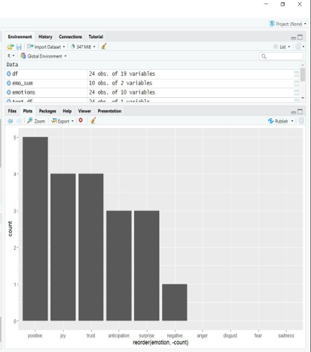
Visualizing Sentiment Scores: Use visualizations, such as bar charts or line graphs, to present the sentiment scores obtained from the sentiment analysis process. This allows for a quick understanding of the distribution and variations in sentiment across different products or user comments.
Fig. 01 Bar Plot

Slide 15
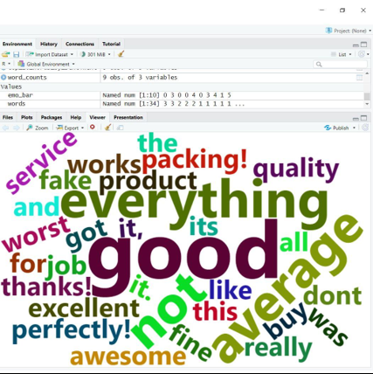
Keyword Clouds: Include the screenshot or generated word clouds that represent the prominent keywords associated with each sentiment category (positive, negative, or neutral). These keyword clouds visually highlight the frequently occurring words, providing insights into the main themes or topics expressed by users.
Fig. 02 Keywords Cloud

Slide 16
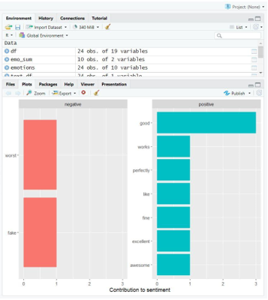
Scatter Plots: Utilize scatter plots to visualize the sentiment categories and sentiment scores of product comments. This type of visualization can help identify patterns, clusters, or outliers in the sentiment analysis results.
Fig. 03 Scatter Plots

Slide 17
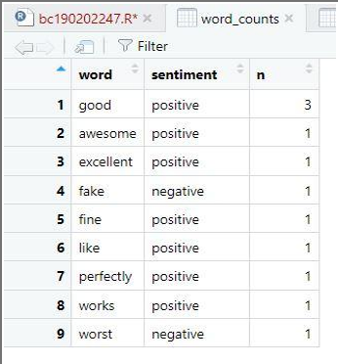
Word Frequency Charts: Present word frequency charts or histograms to display the occurrence frequencies of specific words or phrases within the user comments. This can help identify the most commonly mentioned aspects, features, or issues related to the products.
Fig. 03 Scatter Plots

Slide 18
ACCURACY: Accuracy refers to the measure of how closely the sentiment scores generated by the sentiment analysis tool align with the sentiment ratings provided by users. It provides an indication of how well the tool's automated sentiment analysis matches the sentiments expressed by users in their comments.
Data Comparison:
Compare the sentiment scores generated by the sentiment analysis tool for each comment with the sentiment ratings provided by users.
This involves matching the sentiment scores and sentiment ratings for each comment to determine if they align in terms of positive, negative, or neutral sentiment.

Slide 19
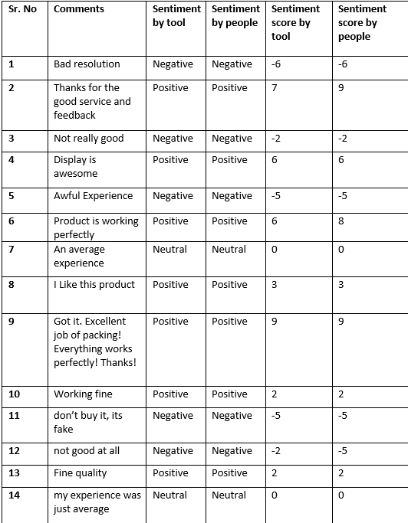


Slide 20
Conclusion and Future Work
Conclusion:
In the conclusion, I am summarizing the key findings and outcomes of this project. Highlight the successful development of the online shopping website with sentiment analysis capabilities.
Discussed how the sentiment analysis tool effectively analyzed user comments, providing valuable insights into customer sentiment towards the purchased products.
Emphasize the positive impact of sentiment analysis on the decision-making process for potential buyers and the overall user experience on the website.
Implications and Recommendations:
Based on the analysis results, identify the implications for online shopping website. Discuss the strengths, weaknesses, opportunities, and challenges identified during the evaluation process.
Recommend improvements to enhance the sentiment analysis feature, such as refining the sentiment scoring algorithm or expanding the lexicon to capture a broader range of sentiments.
Suggested ways to leverage the sentiment analysis results, such as utilizing positive sentiment to promote highly rated products or addressing negative sentiment through proactive customer support.

Slide 21
Limitations and Challenges:
Acknowledge any limitations or challenges encountered during this project, like limited availability of training data for sentiment analysis or potential biases in user-generated content.
These limitations may have influenced the accuracy or comprehensiveness of the sentiment analysis results.
The importance of addressing these limitations in future work to improve the robustness and reliability of the sentiment analysis component.
FUTURE WORK:
Considering integrating advanced sentiment analysis techniques like aspect-based sentiment analysis or sentiment analysis in multiple languages.
Propose the integration of user feedback loops to continuously update and enhance the sentiment analysis model.
Explore the possibility of integrating sentiment analysis with personalized product recommendations to offer tailored suggestions based on individual sentiment preferences.

Slide 22
Tools
PHP: A server-side scripting language used for developing the dynamic functionality of the online shopping website.
MySQL: A relational database management system used for storing and managing data related to products, user information, comments, and ratings.
PHP-Sentiment-Analyzer: A sentiment analysis tool implemented in PHP that utilizes the VADER (Valence Aware Dictionary and sentiment Reasoner) lexicon and rule-based approach to analyze sentiments in user comments.
R Statistical Tool: Used in conjunction with the ggplot2 library for visualization purposes. It allows the creation of scatter plots to visualize sentiment categories for product comments.
Word Cloud Generator: A tool or library used to generate word clouds representing the most frequently occurring keywords in user comments. The specific tool used for word cloud generation in your project is not mentioned, but there are various libraries available in different programming languages, such as wordcloud in R or wordcloud2 in JavaScript.
IDE: Visual Studio Code 2019 (VS Code): An integrated development environment used for coding and managing project files.

